Slide 1


Capstone Project 1
Play store app review analysis
Done by:
JAVED AHMAD

Slide 2
Content
Introduction
Problem Statement
Attributes in Data
Data cleaning
Transforming Data
Data exploration
Basic observation
Insights from data
Conclusion

Slide 3
WHY WE ANALYZE THE PLAY STORE?
Smartphone users spend an average of 3 hours and 15 minutes daily just looking at their phones.
Google Play Store is one of the largest digital markets with its service area. As of 2022, almost 3.3 million apps are on the Google Play Store, and 1 million developers from 150 different locations have published apps.
Mobile games will cover 13% (446,836) of all apps on the Google Play Store in 2022.

Slide 4
Introduction
Google Play was launched on March 6, 2012.
Google Play is an online store where people go to find their favorite apps, games, movies, TV shows, books, and more.
It provides 2 million apps & games to billions of people around the world, generating over $120 billion in earnings for developers to date.
The main objective of the Project is that to understand the Users demand what they expecting from using their apps and thus it helps to update and develop the product by Developers.

Slide 5
Problem statement
Two datasets are provided, one with basic information and the other with user reviews for the respective app.
We must examine and evaluate the data in both datasets in order to identify the important characteristics that influence app engagement and success.
For this project we analyze Play store data of 2017-2018 ,Google playstore is mostly use app store worldwide also top global market share.
Our main objective is to find key factor responsible for app success
and engagement of users.
Thousands of new app regularly update playstore of different category.
We found distribution of every app based on their size, installs, reviews and much more.

Slide 6

Attributes in Google Playstore Data
This contains data on the Google Play applications. It has 10,841 rows of data which has following columns.
App Category: Category of the app. This could be beauty, business, medical,art and design entertainment, education, family...etc.
Rating: It has How users rate the app out of 5, with 1 being the lowest rating and 5 being the highest.
Reviews: number of user reviews each app has received.
Size: The memory size needed to install the application.
Installs: The number of times each application has been installed by users.
Type: Whether the app is free or a paid app.
Price: The price of the app.
Content Rating: This column specifies the intended audience for the app. Can be for teens, mature audience, or everyone.
Genres: The sub-category for each app. Example: for the Education category, this could be Education: Pretend Play, for example.
Last Updated: Release date of the most recent update for the app.
Current Ver: The app's current version.
Android Ver: The oldest version of Android OS supported by the app.

Slide 7

Attributes in User Reviews
Sentiment Analysis: This file contains the result of the sentiment analysis conducted by the dataset creator. It has 64,295 rows of data with the following columns:
App : Name of the app.
Translated_Review: Either the original review in English, or a translated version if the orignal review is in another language.
Sentiment: The result of the sentiment analysis conducted on a review. The value is either Positive, Neutral or Negative.
Sentiment_Polarity: A value indicating the positivity or negativity of the sentiment, values range from -1 (most negative) to 1 (most positive). Sentiment polarity for an element defines the orientation of the expressed sentiment, i.e. it determines if the text expresses the positive, negative or neutral sentiment of the user about the entity in consideration.
Sentiment_Subjectivity: A value from 0 to 1 indicating the subjectivity of the review. Lower values indicate the review is based on factual information, and higher values indicate the review is based on personal or public opinions or judgements.

Slide 8

Data Cleaning
Google Play store dataset has 10,841 observation of data with fields.
User reviews dataset has 64295 observation of data with fields.
Two data set -1) play store data 2) user reviews
List of fields:
App
Category
Rating
Reviews
Size
Installs
Type
Price
Content rating
Genres
Last updated
Current version
Android version
App
Translated review
Sentiment
Sentiment polarity
Sentiment subjectivity
Playstore data
User reviews

Slide 9
Cleanse and validate data
Understand the structure of the dataset and clean data before analysis
Removing extraneous data
Finding Missing value in dataset.
Correct data type(INT, FLOAT, DATE).
Replace null value with aggregate function (mean, mode , median).
Checking outliers.
Conforming data to a standardized pattern.

Slide 10
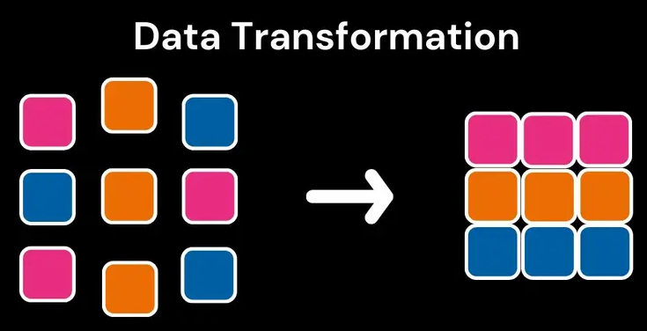
Transform data
Transforming data is the process of updating the format or value entries in order to reach a well-defined outcome, or to make the data more easily understood by a wider audience.
The dataset collected from the Play store is semi structured or unstructured and contains significant superfluous data (defined as not contributing significant meaning).Some data type needs to change in required format as int, float, date.
Since, size of the applications present in the dataset are in MB and KB. Therefore, for ease in data processing, entire size column is converted to MB.

Slide 11

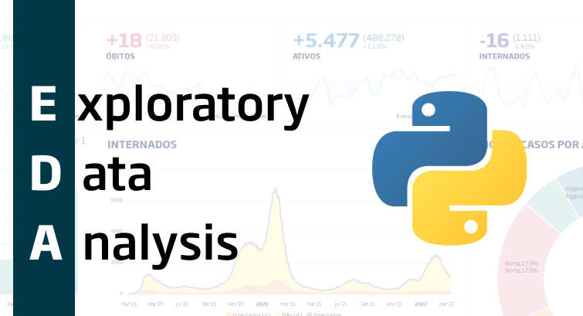
Exploratory data analysis
Exploratory Data Analysis (EDA) is an approach to analyze the data using visual techniques. It is used to discover trends, patterns, or to check assumptions with the help of statistical summary and graphical representations.
Exploratory data visualizations (EDVs) are the type of visualizations we assemble when we do not have a clue about what information lies within our dataset.

Slide 12
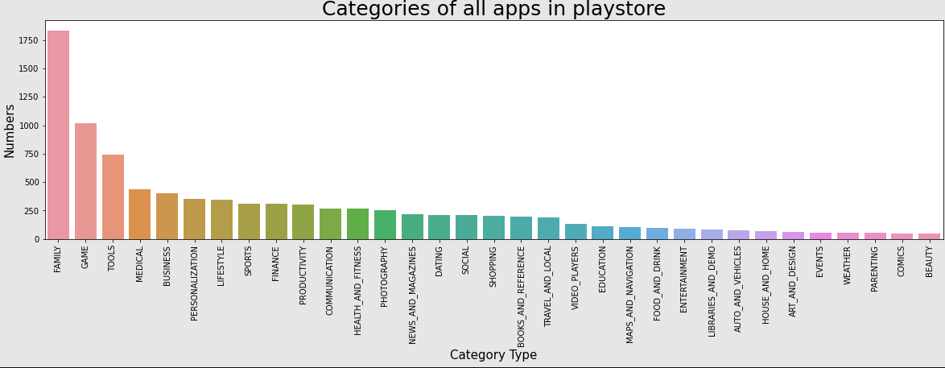
Number of Apps with categories
Based on the 33 categories data set result most application belong to Family, Game and Tools categories and least contribution of Comics and Beauty category in google play store.

Slide 13
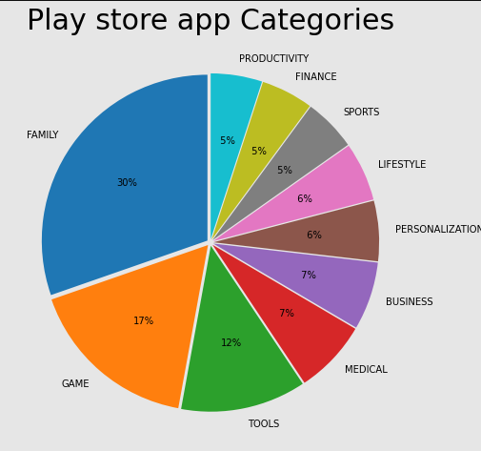
Top 10 Categories
From above pie chart of top 10 Categories 29% apps belong to family,17% app belong to game categories

Slide 14
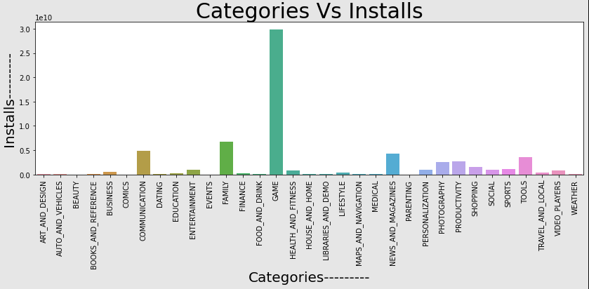
Top Installed Categories vs Categories
We can see that most of the apps has been installed from 'Game' category.

Slide 15
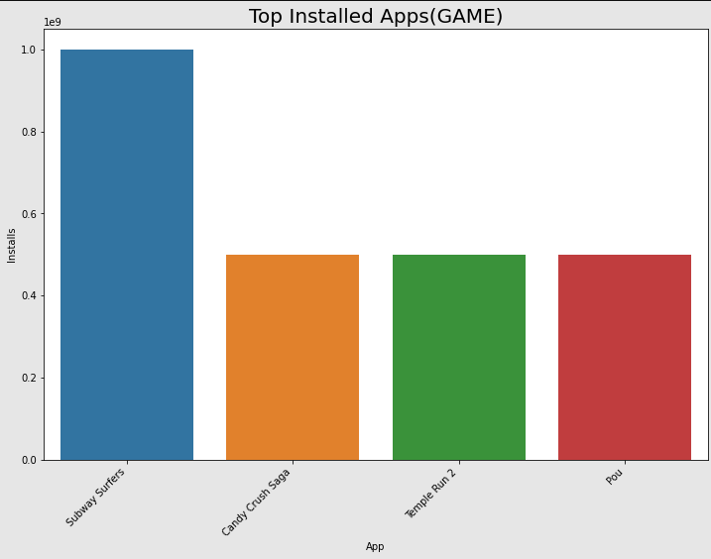
Top Installed gaming Apps
From the above plot we can see that the most installed games from the 'Game' Category are 'Subway Suffers', 'Candy Crush Saga’,’Temple Run 2’and 'Pou'.

Slide 16
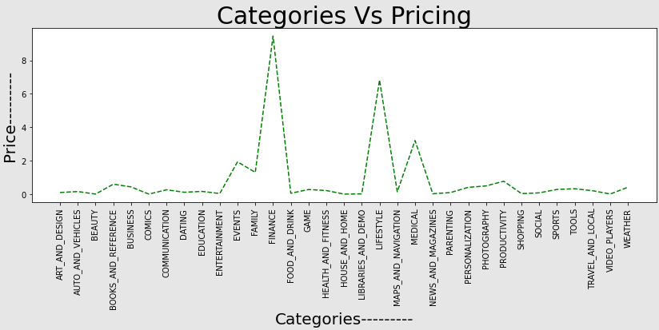
Apps Categories vs Pricing
By above graph it visualize that the prices are high of those apps who belong to Finance and Lifestyle categories.

Slide 17
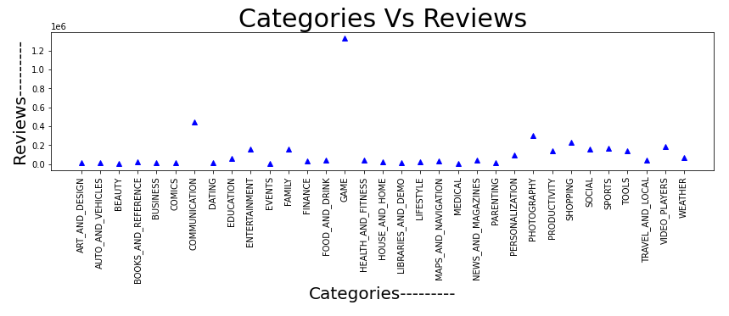
Categories vs Reviews Chart
The reviews are Game categories app is so high..

Slide 18
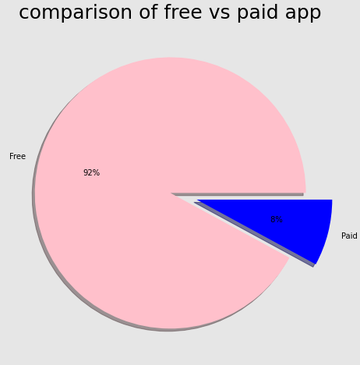
Free Vs Paid Applications
From the pie chart we can see that 92% of apps in google play store are free and 8% apps are paid.

Slide 19

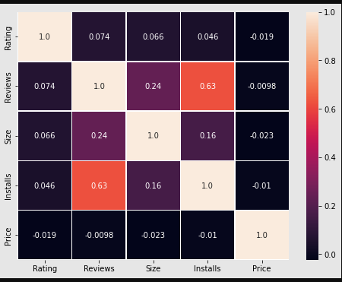
Correlation Heatmap of Columns
From the above heatmap we can see that the 'Reviews' and 'Installs' columns has most correlation.
It is much more obvious that a higher number of installs has a higher number of reviews. There is a negative correlation between price and install apps, with the price of the app influencing the number of installation of the app.

Slide 20

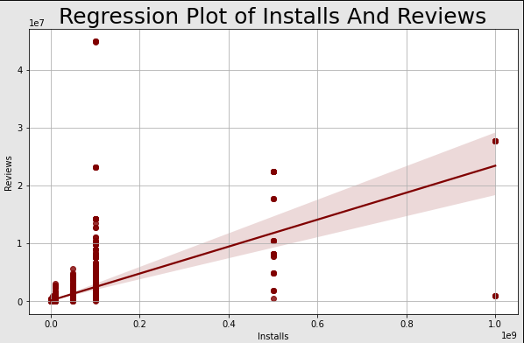
Regression analysis
By above Regression plot it clearly seen that Installs and Reviews are highly corelated.

Slide 21
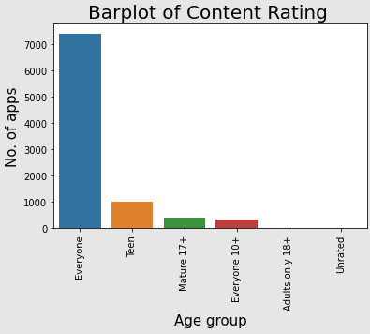
NO. OF Apps vs Content Ratings
From above plot we can seen the most apps come under the Everyone content rating. Content rating of adult and unrated apps are very less.

Slide 22

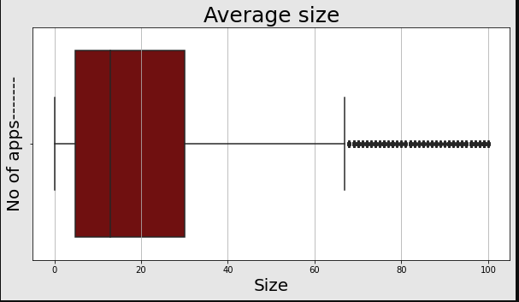
Box plot of Apps according to size
By above box plot we observe that almost 50% apps size lies between 5 MB to 30 MB. Some apps are also present which size greater than the 70 MB.

Slide 23

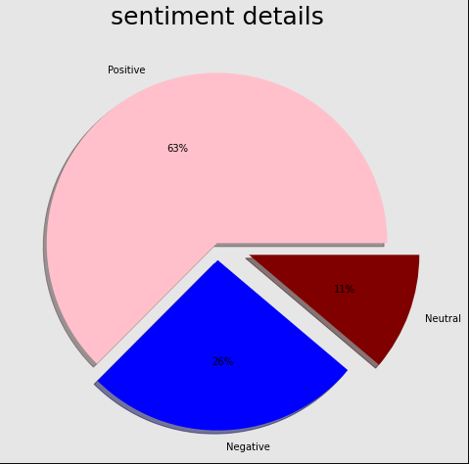
Percentage of Review Sentiments
By above pie chart we can say that positive reviews is high that is 63% ,negative reviews are 26% and neutral reviews are 11%.

Slide 24
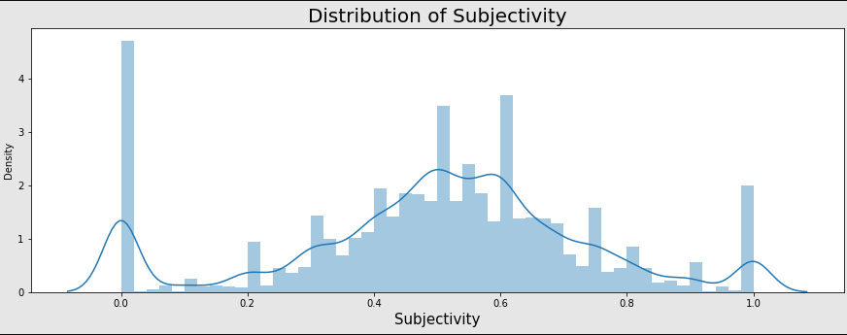
Distribution subjectivity
The maximum number of sentiment subjectivity lies between 0.4 to 0.7. From this we can conclude that maximum number of users give reviews to the applications, according to their experience.

Slide 25

Insights from data
The dataset contains possibilities to deliver insights to understand customer demands better and thus help developers to popularize the product.
Dataset can also be used to look whether the original ratings of the app matches the predicted rating to know whether the app is performing better or worse compared to other apps on the Play Store.
Sentiment Polarity
The polarity of a sentiment measures how negative or positive the context is.
In the data that we have, the polarity ranges from -1 (most negative) to +1 (most positive).
Future Work
Exploring the correlation between the size of the app and the version of Android on the number of installs.
Thus the app development companies could decide what application should be developed and they can also see the prediction of their developed application

Slide 26
Conclusion
Most reviews are for the ‘GAME’ category.
Most installed apps are from 'GAME' and ‘FAMILY' Category.
The price of ‘FINANCE’ and ‘LIFE STYLE’ category apps are high.
Top installed games are 'Subway Surfers', ' Candy Crush Saga' , 'Temple Run 2'and 'Pou’.
Most number of apps belong to family and ‘GAME’ Categories.
The free apps percentage are to high compare to paid app.
Mostly app are come under the everyone content rating.
Positive sentiment percentage for paid apps is more than the free apps.

Slide 27


